Slide 1
ODBC Data Input
PrintNet T

Slide 2
Context Schema
Workflow
Data Input
&
Manipulation
Document
Design
(Layout)
Impositioning
Approval (Proof)
Spool Production
Notes:
Every workflow can contain modules in above mentioned parts.
Each part has different functionality:
Data input, data importing, data preparation
Designing and creating a document
Rotating or resizing a document
Viewing how the document might look like after leaving a printer
Sending the document for printing and specifying properties of the printing and perhaps format of the output file

Slide 3


Introduction
ODBC - (Open DataBase Connectivity)
Connection to various databases (SQL, MySQL,…)
Based on SQL language
ODBC driver necessary
Notes:
ODBC is a programming interface that enables an application to access data in database management systems that use Structured Query Language (SQL) as a data access standard.
The SQL language is English-like in its structure and easy to learn and understand.
The ODBC Data Input module enables you to connect to data from an ODBC source (e.g., Microsoft SQL, Oracle or FoxPro) so that it can be used in your workflow.
Note: An ODBC driver is necessary for ODBC-enabled programs to get information from ODBC data sources. Installation of ODBC and maintenance of the ODBC interface should be conducted using the standard Windows ODBC Control Panel.

Slide 4
Introduction - ODBC Architecture
PrintNet T
Application
ODBC
ORACLE
MS SQL
My SQL
Excel, etc.
Notes:
As you can see from the Schema, PrintNet T communicates with various types of databases via ODBC

Slide 5

Introduction – Unsupported Database Formats
  PrintNet T does not support the following
  formats natively:
  MS Excel
  MS Access
  Therefore we need to use ODBC data input
  Module for accessing them
Notes:
PrintNet T cannot access these formats via regular Data Inputs
Format dBase can be accessed via Data Input module (natively) and also by ODBC data input module (slower, but possible)
The reason why we are mentioning these formats is because they are among the easiest ones and majority of customers are familiar with them.

Slide 6

Accessing An Unsupported
Database File – XLS

Slide 7


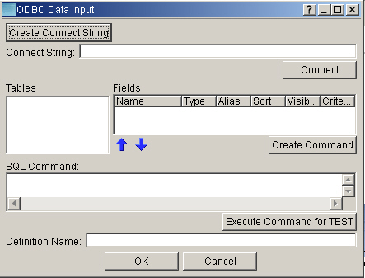
Tutorial I – Accessing XLS File
  First we drag and drop an ODBC Data Input module
  Double click on it and click Create Connect String
Access an XLS file, see its contents and display it in Layout
Notes:
Accessing an Excel file
Names.wfd

Slide 8
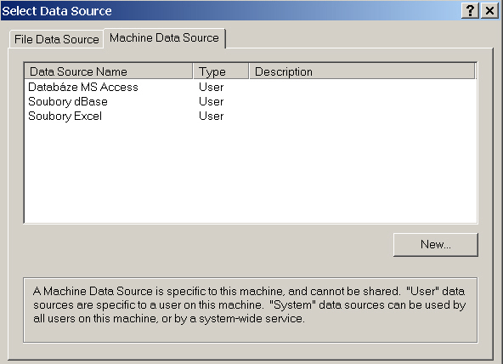

Tutorial I – Accessing XLS File
  In the new window select Machine Data Source
  Select Excel Files and click OK
Notes:
Through Machine Data Source we are accessing the types of files stored in the computer system
It is possible to select from more Data Source Types and also it is possible to select them from a list by clicking NEW button
Note: The list of available machine data sources might not appear, therefore we will click on NEW button and select them in a new window. These available machine data sources are the ones which I have installed on my computer and can be found inside Administrative Tools\ODBC data sources

Slide 9
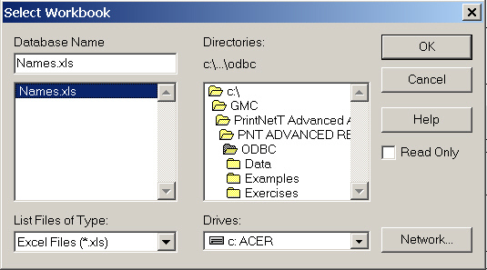
Tutorial I – Accessing XLS File
  A new window appears
  We must select the file to access and click OK
Notes:
Browse through directories to select the file Names.XLS

Slide 10
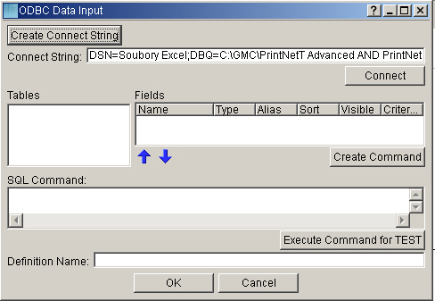
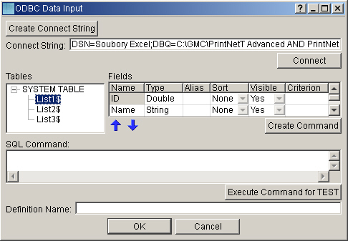
Tutorial I – Accessing XLS File
  After that, it brings the user back to the initial screen
  Click on the Connect button
  All available tables are displayed with possible values
  Then, click on the table that should be displayed
Notes:
Now there is connect string created. This connect string can also contain passwords when I am using another than windows authentication for accessing database (this does not apply to Excel files, but to MSSQL,…)
Connect button connects PrintNet T to the desired file
In this case there are three tables because they are included in every XLS file by default
By selecting the particular table, its content is displayed in Fields window
There are various fields:
Name – displays the name written in the XLS file
Type – displays the type of variable also specified in the XLS file
Alias – displays the name of the variable which will be used for further processing, so it is possible to define own name of variable
Sorting – variables sorting (descending, ascending, none)
Visible – variables availability for further processing
Criterion – sorting criterion

Slide 11
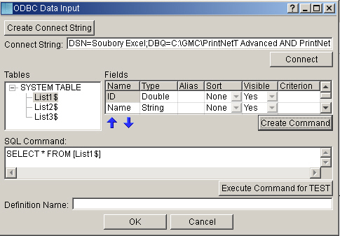
Tutorial I – Accessing XLS File
  By clicking Create Command we generate an SQL command
  For ‘proofing’ the command, click Execute Command
Notes:
The advantage of using SQL command is that this command is executed on server which might not be running on our computer, therefore it does not consume the memory of our computer but it is processed on the server. However, the data must be downloaded to our computer anyway.
By SQL command we specify which values we would like to use and what their settings are, so in this case we are just selecting all values (by inserting ‘*’) without any modifications
If we want to specify a selection, then we set our settings for variables in Fields window, click Create Command and PNT will generate an SQL command automatically (of course it can be done manually as well)
When I have defined SQL command for data selection from my database, it is possible to simply copy this SQL command and paste it into SQL Command Field
In Definition Name window we can specify the name of the array of the imported values (otherwise it will remain the same as the name of the table, i.e. List1$)

Slide 12
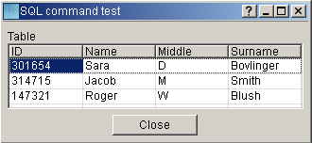
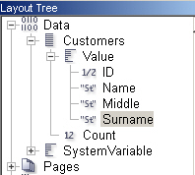
Tutorial I – Accessing XLS File
  The proof window appears
  The data is not sorted or modified
  We can check the data availability in Layout as well
Notes:
The data we specified (in our case all the data) is available in Data tree in Layout

Slide 13
Exercise I – Accessing XLS File
  Start a new WFD file
  Your workflow contains only 2 modules
  Your workflow must import ‘Calls.xls’ file
  Rename the Data Array as ‘Calls List’
  Display its contents in Layout in a table on a single page
  For displaying correct time, use time output format conversion
  Check the resolution in ‘Calls.wfd’
Import a file, rename the main array and display its contents in Layout.

Slide 14

Processing XLS File Using PNetTC.exe
  It is also possible to process an XLS file or access a database via
  PNetTC.exe
  Commands and attributes used:
  PNetTC.exe – runs PrintNet T command line version
  FileName.wfd – specifies the address of the WFD file containing ODBC DataInput module which has SQL command generated and data structure defined
  -conModuleName – label after which a connection string is defined
  -e – label after which a format type is defined (e.g. PDF)
  Other additional attributes and commands
Notes:
The reason for using PNetTC.exe is that some customers might be using console application.

Slide 15
Tutorial II – Accessing XLS File Via PNetTC.exe
Run a PNetTC.exe, access a WFD file, assign a new XLS source
file – Names2.xls to it and print a PDF.
  Copy ‘Names.wfd’ and ‘Names2.xls’ file into the installation PrintNet T directory
  Run command line
  Write the following string into a command line:
  PNetTC.exe Names.wfd -conODBCDataInput1 "DSN=Excel Files;DBQ=Names2.xls;DriverId=790;MaxBufferSize=2048;PageTimeout=5;" -e PDF
Notes:
Example of use: We define our design in WFD file and we access data via ODBC Data Input module. Later on, we would like to use another data file with the same data structure, one way how to do it is via command line version.
Note: This string is a fundamental part of connection string generated via
ODBC Data Input module. So if we want to create the connection string, we should open our accessed file in ODBC Data Input module and generate the string. Then we can copy this string into our command line. This string contains DSN=SouboryExcel…., but if you have an English version of windows, it will be DSN=ExcelFiles…
Before running this command line command, we have to make sure that our accessed WFD file has defined data structure in ODBC Data Input module corresponding to our data file. If we do not define the structure and the ODBC module will be empty, command line version will generate an error.
Solution at ODBC_PNetTC.bat

Slide 16
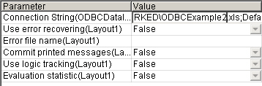
Tutorial III – Source File Update
  Either repeat the previous procedures for accessing XLS file
  Manually change the name in connect string in ODBC module
  Use command line
  Use production window:
  In this example try to print document with “changed” source file
  ‘Names2.xls’. Use the previous ‘Names.wfd’ file.
Suppose that the address/name of the source has changed.
Update name of the XLS input file.
Notes:
Names.wfd
Try all four types of solution

Slide 17
Data Sorting And Filtering
Example of use:
We would like to generate letters for our local branch only to clients from e.g. New York City
We do not want to generate letter for all the clients
Their ID’s are larger than 200 000, because those are our new clients and we would like to inform them about our new services possibilities

Slide 18
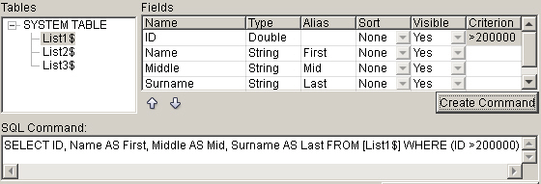
Data Sorting And Filtering
  Variables can be:
  Renamed
  Sorted
  Filtered (Yes/No option)
  Filtered (Condition)
Notes:
It is possible to manually specify the conditions in SQL command (e.g. ID is greater than 200000 and smaller than 205000 -> (ID > 200000) and (ID < 205000))
Rename (Alias) – name of a variable for further processing (in our case First, Mid and Last, variables Name, Middle and Surname will be renamed)
Sort – sort variable (Descending, Ascending, None)
Visible – only Yes/No option, specifying whether the variable will be available for further processing
Criterion – filtering condition specification, specifying which values will pass for further processing (e.g. >10, <10 or = 10) – in our case >200000
Note: there is no == (double equal) condition as in scripting
If there is a string criteria then the string must be in single quotes (e.g. ‘New York’)
Note: This Create Command button and this Fields window serves as wizard for SQL command creation. If we specify the conditions and then just click OK without creating command, our settings are not applied.

Slide 19
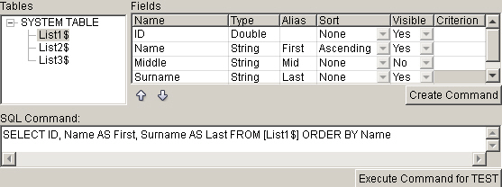
Tutorial IV – Data Sorting
  We select Name to be Ascending and Middle name not to be
  visible
  After we click Create Command, the settings are applied
Sort the data from ‘Names.xls’ according to Name and do not
display Middle name
Notes:
Names2.wfd
In Fields table, we can see the name of the variable, its type, whether we sort the value or not, whether it is available for further processing or not and also criteria (e.g. if the value is greater than 10 we type in >10)
When we want to specify which variables to select, we can simply separate them by ‘,’ in SQL command.
After pressing Execute Command for TEST we will see the proofed data, sorted by name and without Middle name
Note: If we specify more conditions, e.g. the name will be sorted in an ascending order and the surname in a descending order, so that these conditions might influence each other, only the first condition will be applied. But suppose there are three clients “Anna Black”, “Sara Bowlinger” and “Sara Fox”, when we apply the above mentioned settings, then the clients will be sorted first by names and suppose they have the same name, then the second condition for the surname is applied.
We can check the data availability by viewing the data in Data Tree in Layout

Slide 20
Exercise II – Accessing XLS File, Data Sorting
  Access ‘Calls.xls’ file via ODBC module
  Rename Price variable as Cost
  Sort the data by Units greater than 400 in an ascending order
  Do not show the call time and date
  Name the data array as ‘Calls List’
  Check the solution in ‘Calls2.wfd’
The company needs to display customers’ data and shows only greater calls (>400 units) and does not show unnecessary data

Slide 21

2. Accessing a Database – MSSQL
Notes:
It is necessary to ask the customers whether they want to install MSSQL server on their computer. If they do not want to, then the trainer will show it on his own computer.
There are different types of databases:
Small (personal)
Access
MySQL – functional limitations
Medium
MSDE – Microsoft Desktop Engine (small enterprises), no GUI tools
Big
MSSQL, Oracle (great enterprises), GUI tools

Slide 22


Data Flowing from Database into Application
ODBC driver
PrintNet T
MS SQL
Server
Database
Table
Notes:
In this schema there is an MSSQL Server which contains a database. This database has data inside including tables.
Through ODBC driver a client can access this database (table) and use it in PrintNet T.
Ask the customers if they want to install MSSQL database on their computers or not. If so, switch to presentation for installation of the database (PNetT_Training_Advanced-MSSQL_Installation_Data_Filling.ppt). If they do not want to install it, continue the examples and exercises only on trainer’s computer.

Slide 23
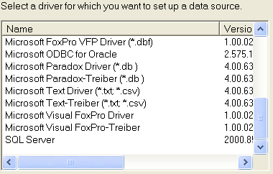
Tutorial – Accessing MSSQL via ODBC Module
  Double click on ODBC module, Create Connect String button
  Switch to File Data Source and click New
  List a new source in the displayed window
Access the MSSQL database via ODBC Data Input module and
display content of ODBC Customers database.
Notes:
File Data Source describes the driver that you wish to connect to. You can use any file data that refers to ODBC driver installed on your computer
Note: For older types of windows, these drivers might not appear. Therefore, it is necessary to install these drivers.
Note2: If we include the e.g. XLS file in our WFD file, the ODBC as a Windows component does not see this file, which is included. Therefore, this file must be physically on the disc.

Slide 24
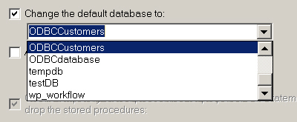
Tutorial – Accessing MSSQL via ODBC Module
  Click Next and select the location where to store the connection
  information
  In the next window select to use local server, click Next
  Afterwards, users must specify the accessed database (in our
  case ODBCCustomers)

Slide 25
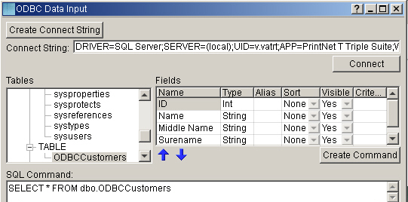
Tutorial – Accessing MSSQL via ODBC Module
  After finishing the connection specification the original window
  appears
  Select the connection file and click OK
  The following process will be identical with Example I

Slide 26
Exercise III
  Create a new database, fill it with data from ‘Names3.xls’
  Access this database in PrintNet T
  Do not show the middle name and name
  Show only clients from New York and with ID greater than 300 000
  Sort the data according to surname
  Name the array ODBCClients and display it in a table in Layout
  Use MSSQL database to store calls data. Then access the data using ODBC module, sort it and filter it according to specified criteria.
Notes:
In this exercise we have a database of clients from different cities. We would like to see a sorted list of all of the customers only from New York. Because we want to list only a new customers, we need do display only ID’s greater than 300 000. We need to see only short list of customers, therefore we do not display Middle Name and Name.
Resolution: Names3.wfd (it has link to Excel file containing data, because the database (and it link) will be created and filled later in order to show trainees how to do it)

Slide 27

ODBC Data Input – Summary
In this presentation we have learned how to:
Access MS Excel file via ODBC Data Input module
Access MSSQL database ODBC Data Input module
Modify the data settings imported via ODBC Data Input module (sorting, conditional filtering, renaming, etc.)
Change the name and location of the database when sending file for production

Slide 28

ODBC Data Input – Discussion
How would you:
Generate SQL command?
How would you specify that the name or location of database has changed?
Is it possible to specify that we would like to rename the names of the variables, sort them and filter them using ODBC Data Input module?
Notes:
1. Either manually (I will know the SQL command based on definition from my own database) or automatically by pressing Generate SQL Command
2. Either generate a new connection string or manually change the previous generated one, specify it in command line or change it in production window
3. Yes, it can be specified in Fields window of ODBC Data Input module

Slide 29

Thank You.
Do You Have Any Questions?

